Slide 1
MIS VIVA-4
ASSIGNMENT

Slide 2
SUBMITTED BY TEAM-11 BATCH-A
TEAM MEMBERS ARE
VIKHYAT BANSAL - [CB.EN.U4AIE21076]
VIGNESH - [CB.EN.U4AIE21075]
MAAREDDY MOHIT SASANK REDDY - [CB.EN.U4AIE21031]
YARAM SRI SATHWIK REDDY - [CB.EN.U4AIE21077]

Slide 3
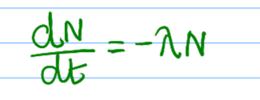
01
In nuclear physics, the radioactive material like
uranium undergo nuclear fission and releases energy
and creates a daughter nucleus. The decay of the radioactive material is dependent on the number of nuclei available for nuclear fission.
An important timescale associated with radioactive decay is the half-life of the material. It is the time required for the number of nuclei to be half of its initial value. Derive the half-life of the radioactive material in terms of the decay rate λ. Assume the initial value of the thorium nuclei to be 10,000 and decay rate to be 0.2, find the half-life of the thorium.

Slide 4
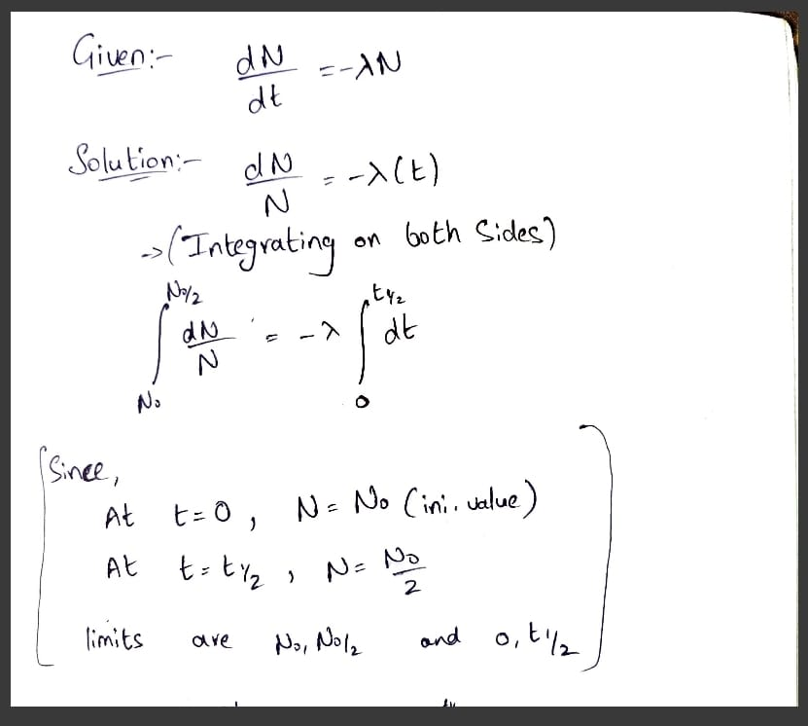

Slide 5
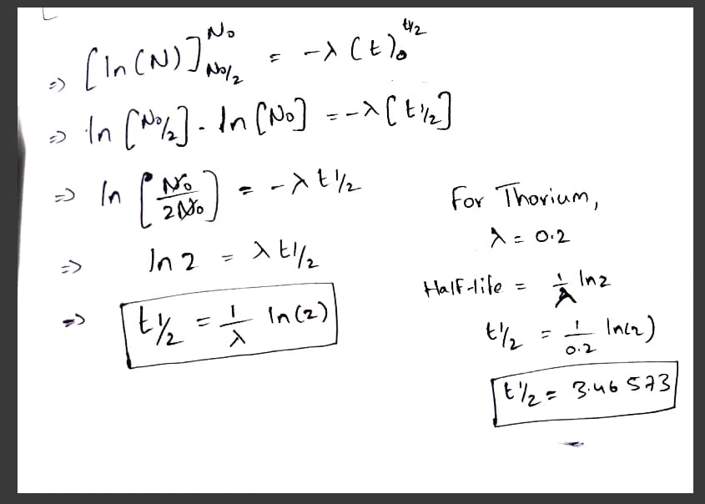

Slide 6
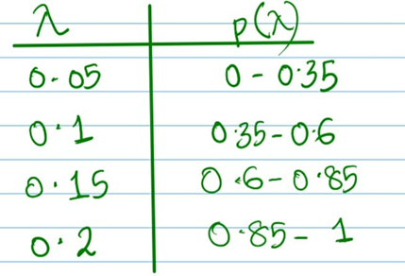
02
Use the Monte-Carlo simulation for simulating the decay; for 0<t<100 seconds with 2000 datapoints; with discrete distribution function defining the decay rate as tabulated below
Plot the number of nuclei versus time for the Monte-Carlosimulation. Find the number of nuclei corresponding totheoretical half-time

Slide 7
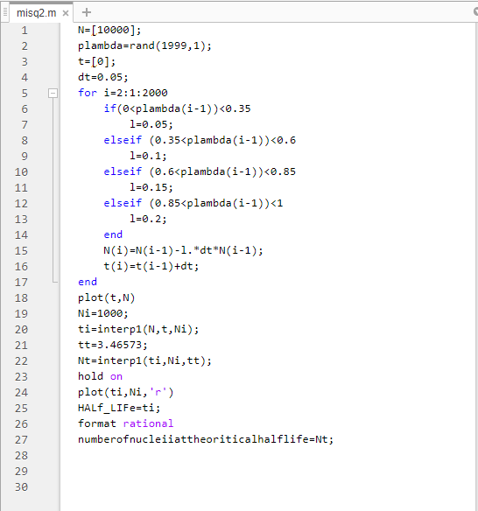
MATLAB CODE:

Slide 8
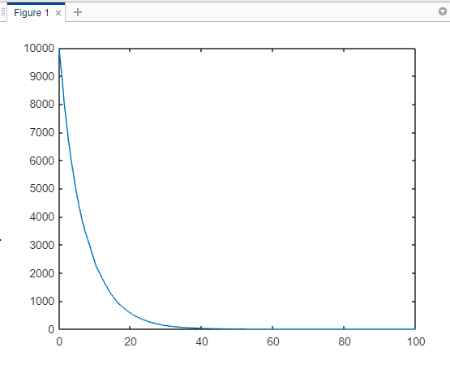
GRAPH:

Slide 9
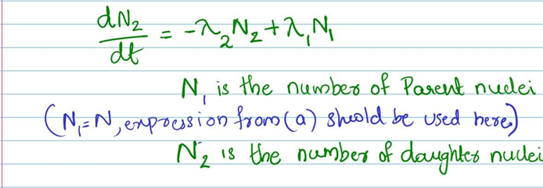
03
The daughter nuclei can also be radioactive and will also undergo radioactive decay. This happens for materials like uranium and thorium. The amount of daughter nuclei is determined by two processes:
(i) radioactive decay and (ii) radioactive growth by decay of the parent nuclei, respectively:
Derive the number of daughter nuclei in terms of decay rates of λ1and λ2.

Slide 10
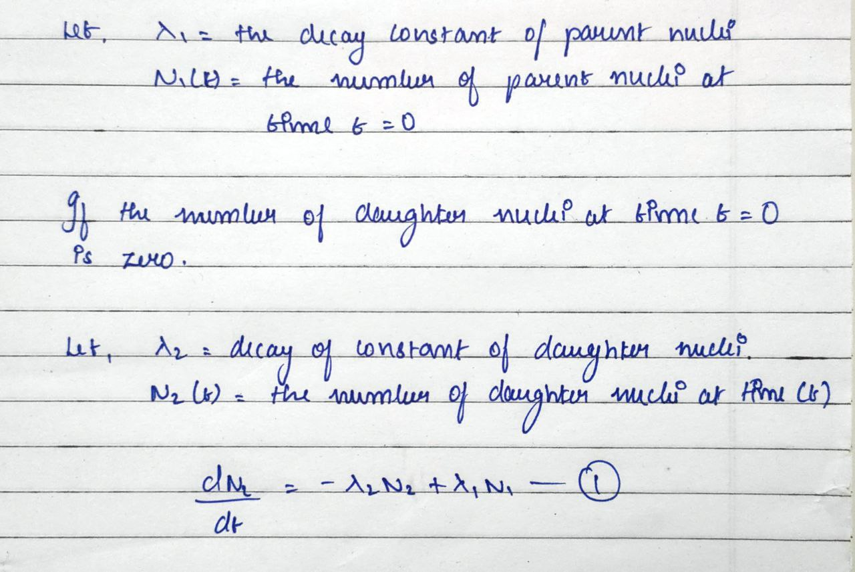

Slide 11
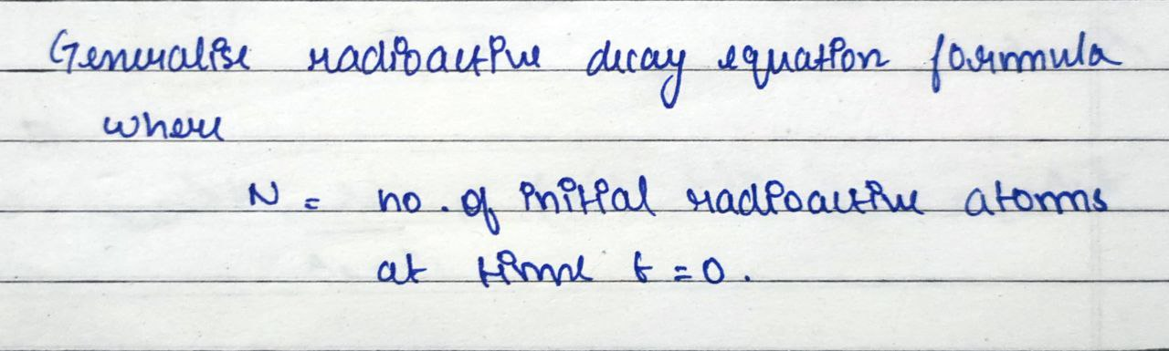
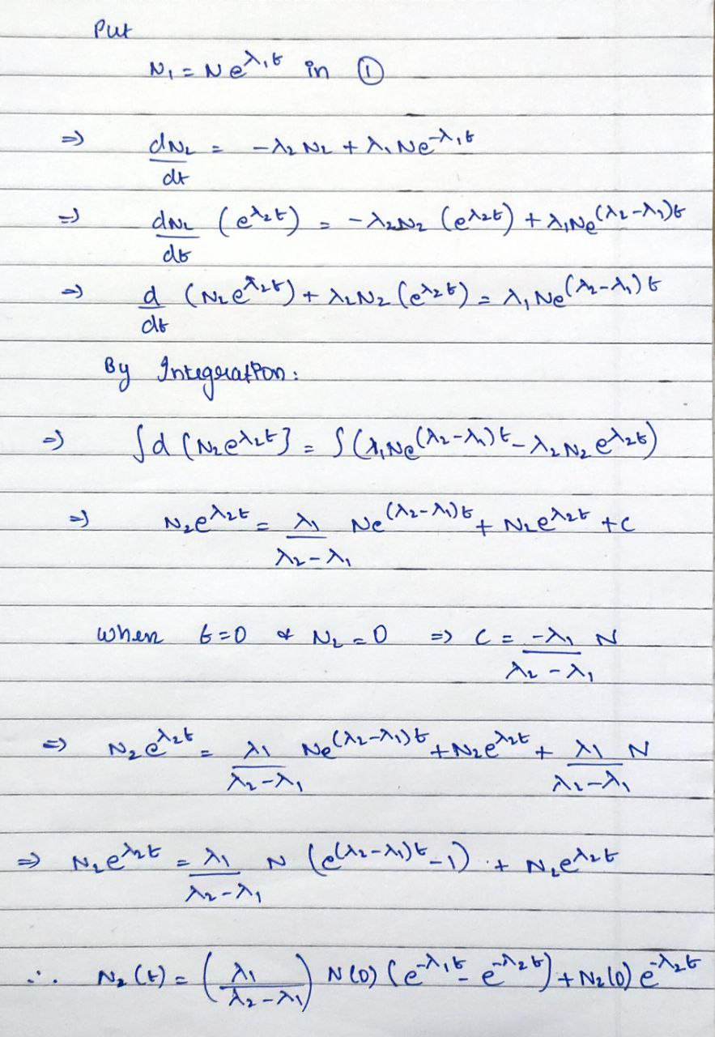

Slide 13
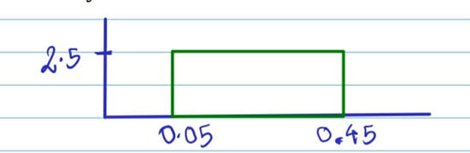
04
Use the Monte-Carlo simulation for simulating the decay; for 0 < t < 100 seconds with 2000 datapoints; λ1 is the discrete probability distribution as given in (b). λ2 is defined by the uniform probability distribution function as shown below.
Plot the number of nuclei versus time; Find the number of daughter particles at the half life of the parent nuclei. Physically λ can never be negative, because the radioactivematerial will only decay. Therefore take absolute value fromthe normal distribution.

Slide 14
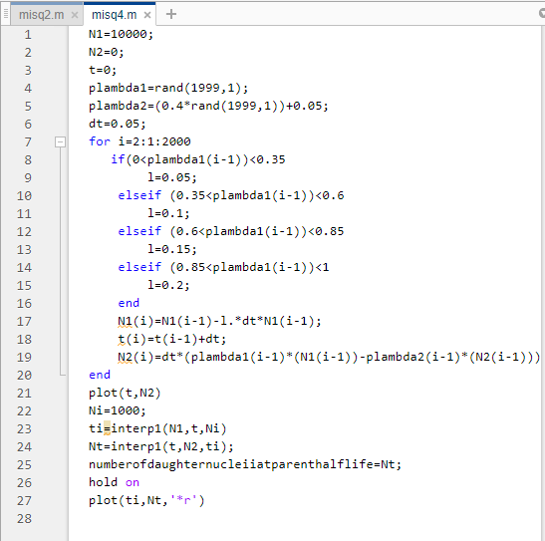
MATLAB CODE:

Slide 15
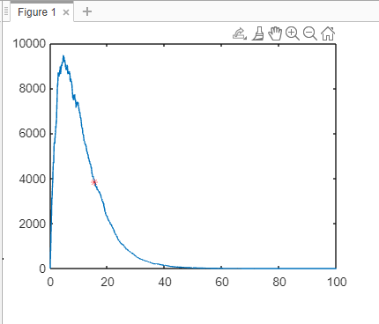
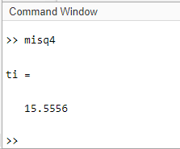
GRAPH:

Slide 16
Thank you!

